Slide 1


Linux and Shell Scripting
Dr. Sheikh Umar Mushtaq
Assistant Professor

Slide 2
CAP 443
Network configuration
Using IP Ping
Ping using DNS

Slide 3
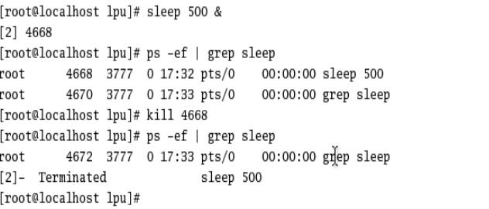
Process Management Utilities:
Commands like ps, kill, and top allow users to view and manage running processes.

Slide 4
Network Utilities:
Tools like ping, ifconfig, and netstat assist in network configuration, diagnostics, and monitoring.
netstat -tuln
-t → TCP connections
-u → UDP connections
-l → Listening ports
-n → Show numeric addresses (instead of names)

Slide 5
Ifconfig
1. lo → Loopback interface
Special interface that connects the system to itself.
IP 127.0.0.1.
Used for testing and internal communication.
2. eth0 → Ethernet interface
This is your VM’s virtual network card.
It is used to connect to the outside world (LAN, internet, or host system).
The IP you see under eth0 is the address your VM uses to communicate.

Slide 6
Text Processing Utilities:
Utilities such as grep, sed, and awk are used for text searching, manipulation, and processing.
Grep: write any text in text file and use grep to find the particular line by using search word. Eg. grep search_word test.txt
grep “lpu" file1.txt file2.txt
grep -i "linux" file1.txt file2.txt <<<<<<< Search ignoring case (case-insensitive)
grep -c "Linux" file1.txt file2.txt <<<<<< Count number of matching lines
grep -n "Linux" file1.txt file2.txt <<<<<<<<< Display line numbers with matches
sed ‘s/lpu/lovely/' file.txt<<<<<<<for substituting

Slide 7
User and Permissions Utilities:
Commands like useradd, usermod, passwd, and chmod are used for managing users and setting file permissions.
Changing File Permissions:
To change file permissions, use the chmod command. For example, to make a file executable:
chmod +x filename.sh

Slide 8
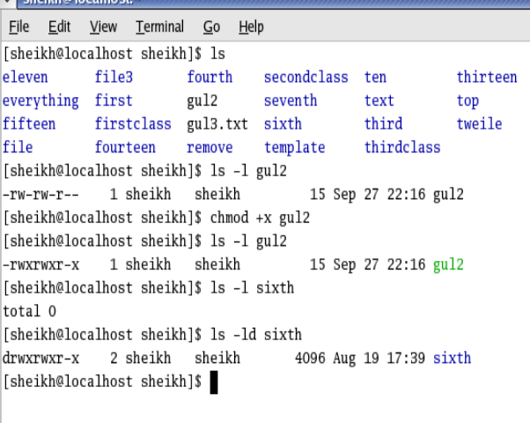
Demonstrating chmod +x with touch
Step 1: Create a new file
Step 2: Check file permissions
Step 3: Add execute permission
Step 4: Check permissions again
The first character (- in this case) indicates the file type.
Meaning of the first character in ls -l:
- → Regular file (normal text, binary, or script file).
d → Directory.
l → Symbolic link.
c → Character device (like keyboard, serial port).
b → Block device (like hard disk).
p → Named pipe.
s → Socket.

Slide 9
chmod o-w → remove write from others
chmod u+x → add execute to user
chmod g-r → remove read from group

Slide 10
The principle of umask
Every new file or new directory in Linux has default permissions:
umask subtracts permissions from these defaults.
Think of it as a filter: it “masks” (removes) certain permissions when the file is created.
Type | Default Permissions
File | 666 → rw-rw-rw-
Directory | 777 → rwxrwxrwx

Slide 11
Do you need to run umask before creating a file?
Yes, if you want the new file to have specific default permissions.
If you run umask 022 before creating a file, the shell applies that mask while creating the file.
If you don’t run umask, the system uses the default mask, usually 0022.

Slide 12
Step-by-step example
Step A: Check default umask
umask
Suppose it shows 0022.
That means: remove write permission for group and others by default.

Slide 13
Step B: Create a file without changing umask
touch file1.txt
ls -l file1.txt
Output: rw-r--r--
Explanation: 666 (default for file) – 022 (umask) = 644 → rw-r--r--

Slide 14
Step C: Change umask
umask 007
touch file2.txt
ls -l file2.txt
Output: rw-rw----
Explanation: 666 – 007 = 660 → owner & group read/write, others nothing

Slide 15
Default: 110 (rw-)
Umask: 111 (rwx)
Result: 110 & ~111 = 110 & 000 = 000 → ---
Take the complement of umask

Slide 16
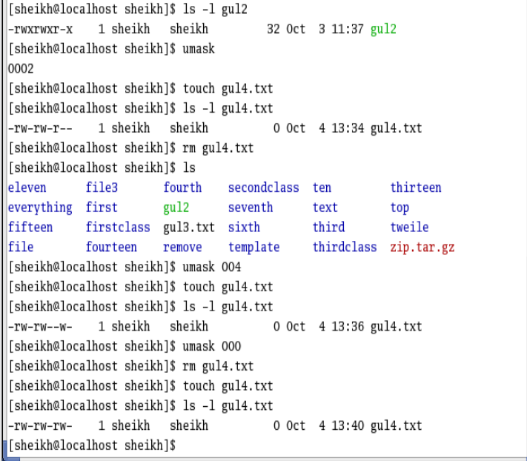

Slide 17
ACL
ACL allows specific users to access files, even if they are not in the group.
setfacl -m u:alice:r myfile.txt
getfacl myfile.txt

Slide 18
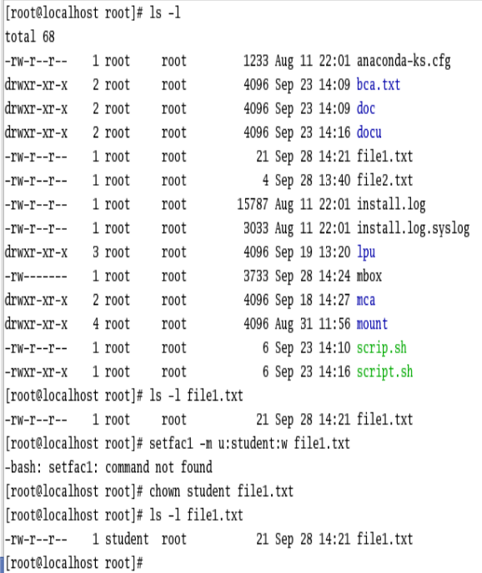
Change ownership

Slide 19
Adding users to the Groups
Check the User and Group
id student1
Step 1: Check Existing Groups
cat /etc/group
Shows all existing groups on the system.
Look for common groups like wheel (admin group) or dev.
Add new group
Groupadd newgroup
Add user to the group
sudo usermod -G wheel student1
Remove User from Group
sudo gpasswd -d student1 dev

Slide 20
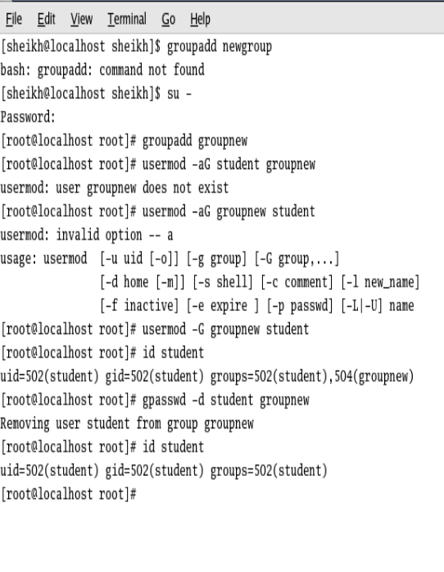

Slide 21
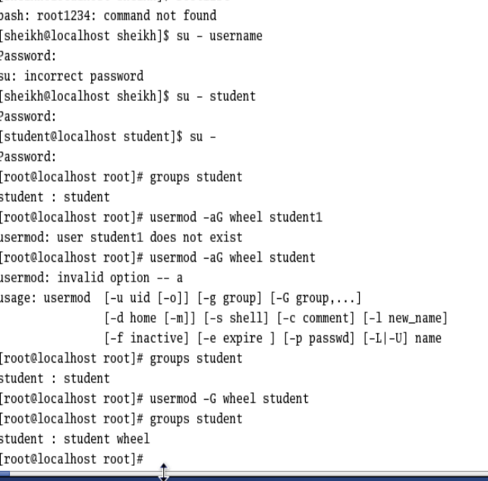

Slide 22
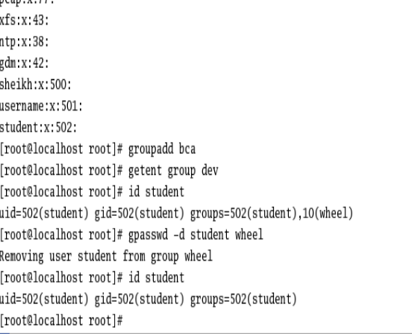

Slide 23
Filtering output: Grep command
Step 1: Create Empty Files
touch file1.txt file2.txt file3.txt
Step 2: Add Content to Files
Step 3:Search for lines containing “search word” in single file
grep search_word file1.txt
Step 4: Search in Multiple Files
grep search_word file1.txt file2.txt file3.txt

Slide 24
grep “lpu" file1.txt file2.txt
grep -i "linux" file1.txt file2.txt <<<<<<< Search ignoring case (case-insensitive)
grep -c "Linux" file1.txt file2.txt <<<<<< Count number of matching lines
grep -n "Linux" file1.txt file2.txt <<<<<<<<< Display line numbers with matches
sed ‘s/lpu/lovely/' file.txt<<<<<<<for substituting

Slide 26
PIPE (|)
In Red Hat Linux, and in Linux distributions in general, the pipe (|) is a powerful feature that allows you to combine and manipulate the output of one command as input to another command.
It enables you to create complex and efficient data processing pipelines. Here's how you can use the pipe in Red Hat Linux:
The pipe symbol (|) is used to connect the output of one command to the input of another command. The basic syntax is as follows:
command1 | command2

Slide 27
PIPE (|)
Step 1: Create a File
touch fruits.txt
echo -e "apple\nbanana\norange\napple pie\nbanana split" > fruits.txt
cat fruits.txt
Step 2: Use Pipe with grep
Find lines containing apple and sort them alphabetically:
grep apple fruits.txt | sort
Explanation:
grep apple fruits.txt → selects lines with apple
| sort → sorts those lines

Slide 28
compression
Step 1: Create some sample files
echo "This is file1" > gul2
echo "This is file2" > gul3.txt
Step 2: Archive them
a) tar -cvf zip.tar gul2 gul3.txt
# output:
gul2
gul3.txt

Slide 29
Step 3: Compress archive
gzip zip.tar
# now you will see zip.tar.gz
Step 4: see the contents of compressed archive
tar -tvzf zip.tar.gz
Step 5: Extract back
tar -xvzf zip.tar.gz
# output:
gul2
gul3.txt

Slide 30
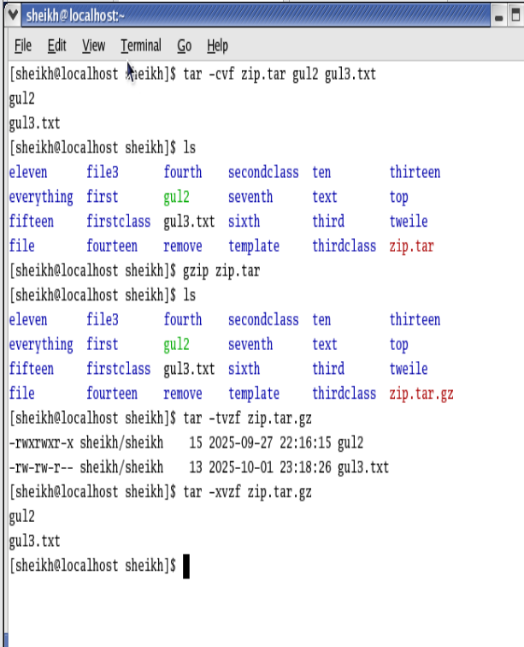

Slide 31
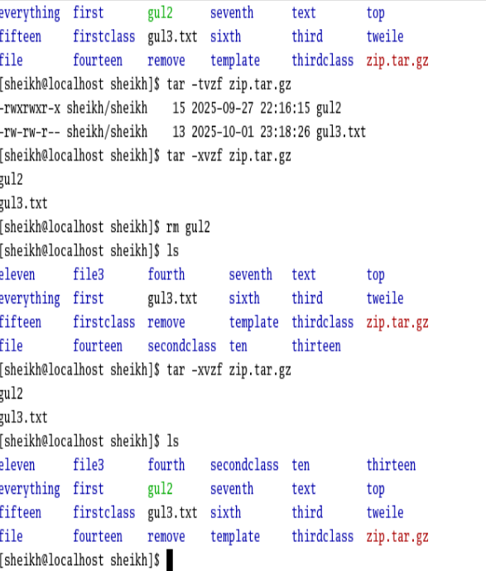

Slide 32
Locating commands
Which ls
Whereis ls

Slide 33
What is an alias?
An alias is a shortcut or nickname for a command or set of commands.
It helps you save typing or simplify long commands.
alias shortname='command_to_run’
Eg. alias ll=‘df -h'

Slide 34
Remove alias
unalias ll

Slide 35
What is history?
history shows a list of commands you have previously executed in the shell.
Very useful to recall or repeat commands.
Run a previous command
Use the number with !:
!3

Slide 36
